Slide 1

ADVANCED OPERATING SYSTEMS WITH UNIX
CH-2

Slide 2
What is Process Synchronization?
In modern operating systems, multiple processes or threads often run concurrently (e.g., multitasking, multiprogramming, distributed systems).
These processes may share resources such as:
CPU
Memory
Files
I/O devices
Process Synchronization is the mechanism that ensures safe and correct execution of such processes so they do not interfere with each other and produce consistent results.

Slide 3
Process Synchronization & Communication (IPC, Semaphores, Monitors, Message Passing)
Process Synchronization
Definition: A mechanism that ensures multiple processes/threads execute in a way that prevents race conditions and guarantees data consistency when accessing shared resources.
Ensures that concurrent processes/threads execute in a controlled manner without interfering with each other.
Focuses on critical section problem.
Problem: When processes concurrently execute critical sections, results may vary → inconsistent data.

Slide 4
The Critical Section Problem
Definition
A critical section is a portion of the program where a process accesses shared resources (like variables, data structures, files, or devices).
If more than one process enters the critical section at the same time → Race Condition occurs.
Race condition = final output depends on the order of execution of concurrent processes.
Example: Two people withdrawing money from the same bank account simultaneously → account balance may become inconsistent.

Slide 5
Critical Section Problem
Critical Section = A code segment that accesses shared data.
If multiple processes enter critical section at once → race condition occurs.
Requirements (Critical Section Problem)
Mutual Exclusion – Only one process executes critical section at a time.
Progress – If no process is in CS, a waiting process must be allowed to enter.
Bounded Waiting – A process must not wait indefinitely to enter CS.
Use Case: Updating a bank balance simultaneously by two ATMs.
ATM withdrawals from the same bank account (two people shouldn’t withdraw simultaneously and cause inconsistency).

Slide 6
Conditions for a Correct Solution
A solution to the critical section problem must satisfy three essential requirements:
Mutual Exclusion
  At most one process can be inside the critical section at any given time.
  Prevents race conditions.
Progress
  If no process is executing in the critical section and some processes are waiting, then one of the waiting processes must be allowed to enter within a finite amount of time.
Bounded Waiting
  After a process has made a request to enter its critical section, there exists a limit on the number of times other processes can enter before this request is granted.
  Prevents starvation (where one process waits indefinitely).

Slide 7
Hardware & Software Solutions
A. Software Solutions
Peterson’s Algorithm
Dekker’s Algorithm
Bakery Algorithm (Lamport’s algorithm for distributed systems)
B.Hardware Solutions
Modern hardware provides special instructions for synchronization:
Test-and-Set (TSL)
Compare-and-Swap (CAS)
Swap Instruction

Slide 8
Synchronization Tools (Provided by OS)
To simplify process synchronization, OS provides high-level constructs:
Semaphores – Integer counters with wait() and Signal() operations
Mutex Locks – Binary locks for exclusive access
Monitors – High-level structure with condition variables.
Message Passing – Synchronization in distributed systems.

Slide 9
Real-World Examples of Process Synchronization
ATM Transaction
  Two users withdrawing from the same account must be synchronized → otherwise negative balance may occur.
Printer Spooling
  Multiple processes sending data to the printer → spooler must synchronize access to avoid mixing outputs.
Ticket Booking System
  Multiple users booking the last seat → synchronization ensures only one gets it.
Database Management
  Multiple users updating the same record in a database → must ensure consistency.
Issues Without Synchronization
If synchronization is not implemented properly:
Deadlock – Two or more processes waiting forever for resources.
Starvation – Some processes never get CPU or resource time.
Race Conditions – Inconsistent or incorrect results.

Slide 10
2.Inter-Process Communication (IPC)
Processes often need to exchange data or coordinate actions.
IPC provides mechanisms for this.
Methods
Shared Memory
  A common memory region is shared among processes.
  Faster, since processes directly read/write memory.
  Needs synchronization (e.g., semaphores).
  Use Case: Databases, multiprocessing systems.
Message Passing
  Processes communicate via send/receive primitives provided by OS.
  Easier in distributed systems.
  Types:
    Direct (explicit process name)
    Indirect (mailbox/queue)
  Use Case: Client-server systems, microkernels.

Slide 11
Inter-Process Communication (IPC) – Detailed Explanation
1. Definition
In a multitasking or distributed system, multiple processes may need to exchange data and coordinate actions.
Since processes are isolated (especially in modern OS where each process has its own address space), they cannot directly access each other’s memory.
IPC provides mechanisms for processes to communicate and synchronize with each other.

Slide 12
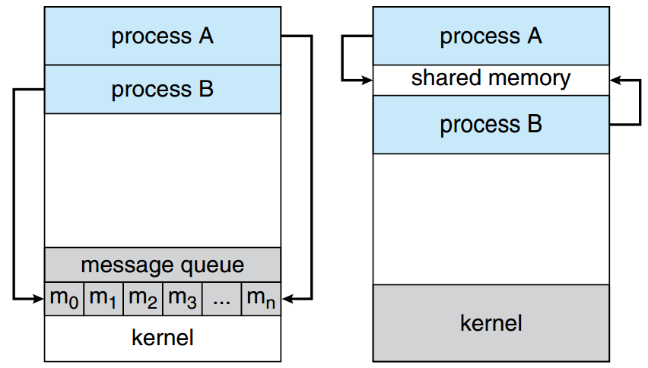
Message passing Shared Memory

Slide 13
IPC Models A. Shared Memory
B. Message Passing
A. Shared Memory
A region of memory is shared among processes.
Processes can directly read/write into this memory segment.
The OS only sets up the shared memory region, but processes are responsible for synchronization (using semaphores, mutexes, monitors).
Features:
Fast → direct access, no kernel intervention after setup.
Efficient for large volumes of data.
Requires explicit synchronization (risk of race conditions).

Slide 14
Message Passing
Processes communicate using messages (send/receive primitives).
The OS provides the mechanism, and ensures correctness.
Useful when processes do not share memory (e.g., in distributed systems).
Features:
Easier for communication across different machines.
Slower than shared memory (since messages go through kernel/communication layer).
Naturally synchronized (send/receive acts as a sync point).
Types of Message Passing:
Direct Communication
  Processes must explicitly name each other.
  Example: send(P1, message) → sends directly to process P1.
  Simple, but less flexible
2.Indirect Communication
Messages are sent via mailboxes (message queues).
don’t need to know each other explicitly.
Example: send(mailbox, message); receive(mailbox, message).
Flexible, supports multiple senders/receivers.

Slide 15
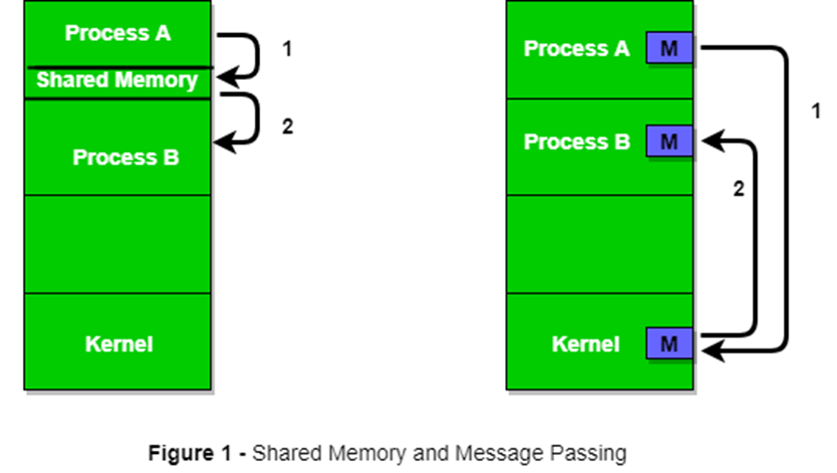

Slide 16
3. Semaphores
Definition
A Semaphore is a synchronization tool used to manage access to shared resources by multiple processes in a concurrent system.
It prevents race conditions and solves the critical section problem.
Introduced by Edsger Dijkstra in 1965
Integer variable used to control access to resources.
Types
Binary Semaphore (Mutex) → Value = {0,1}. Used for mutual exclusion.
Counting Semaphore → Value ≥ 0. Used when multiple resource instances exist.
wait(S) (P operation): Decrement; if value < 0, block process.
signal(S) (V operation): Increment; if value ≤ 0, wake up a waiting process.

Slide 17
Types of Semaphores
Binary Semaphore (Mutex)
  Value: 0 or 1.
  Works like a lock.
  Only one process can access the critical section at a time.
  Example: Controlling access to a printer.
Counting Semaphore
  Value: Any non-negative integer.
  Allows multiple processes to access a finite number of instances of a resource.
  Example: Database connection pool with n connections.

Slide 18
Operations on Semaphores
Two atomic operations are used:
Wait (P or down operation): wait(S): while (S <= 0) do wait; // busy wait S = S – 1 Decreases the semaphore value. If value < 0 → process waits. | Signal (V or up operation): signal(S): S = S + 1 Increases the semaphore value. If processes are waiting → one gets unblocked.

Slide 19
Use Case:
Producer-Consumer problem (buffer management).
Producer puts items in buffer, consumer removes them.
Semaphores control buffer slots (empty/full).
Reader-Writer Problem
Multiple readers allowed, but only one writer at a time.
Semaphores help coordinate access to the shared database.
Dining Philosophers Problem
Prevents deadlocks while philosophers share limited forks
Advantages: ✔ Simple and effective for synchronization. ✔ Prevents race conditions. ✔ Works for single & multi-processor systems. ✔ Can handle multiple instances of resources (counting). | Disadvantages: ❌ Misuse can lead to deadlocks (if all processes wait indefinitely). ❌ Priority inversion → higher priority process waits for lower one. ❌ Busy waiting in naive implementations wastes CPU cycles. ❌ Programming errors (missing wait/signal) are hard to debug.

Slide 20
4. Monitors
A high-level synchronization construct that combines:
Shared variables
Procedures (operations)
Synchronization (condition variables)
At most one process can be active inside a monitor at any time → ensures mutual exclusion automatically.
Condition Variables
Used for process coordination inside monitors.
Operations:
wait() → suspends process until signaled
signal() → resumes a waiting process.

Slide 21
Working of Monitors
At most one process active inside monitor at a time.
If another process calls a monitor procedure, it must wait until current one exits.
Condition variables help manage synchronization dependencies (e.g., producer must wait if buffer is full).
Example: Producer-Consumer with Monitor monitor ProducerConsumer { int buffer[N]; int count = 0, in = 0, out = 0; condition notFull, notEmpty; procedure insert(item) { if (count == N) notFull.wait(); buffer[in] = item; in = (in + 1) % N; count++; notEmpty.signal(); } procedure remove() returns item { if (count == 0) notEmpty.wait(); item = buffer[out]; out = (out + 1) % N; count--; notFull.signal(); return item; } }

Slide 22
Advantages:
Easier to program than semaphores.
Safer (prevents common programming mistakes).
Disadvantages:
Requires language/OS support.
More complex to implement at kernel level.

Slide 23
5.Message Passing
IPC mechanism where processes send and receive messages.
Types
1.Direct Communication
Processes must explicitly name each other.
Example: send(P1, message), receive(P2, message)
2.Indirect Communication
Uses mailboxes/ports. Processes communicate via queues.
Example: send(Mailbox1, message), receive(Mailbox1, message)

Slide 24
Synchronization
Blocking (Synchronous): Sender waits until message delivered; receiver waits until message received.
Non-Blocking (Asynchronous): Sender continues after sending, receiver may poll or get notification.
Use Case: Client-server communication, distributed systems.
Advantages:
Easier to implement in distributed systems.
Provides strong process isolation.
Disadvantages:
Slower than shared memory.
Requires OS kernel overhead for message management.

Slide 25
.
Deadlock Detection
Goal: Allow deadlocks to occur but provide a mechanism to detect them.
(a) Single Instance of Each Resource Type
Use a Resource Allocation Graph (RAG).
Nodes: Processes (P1, P2…) + Resources (R1, R2…).
Edge Types:
  Request edge (P → R): process requests a resource.
  Assignment edge (R → P): resource assigned to process.
Cycle in RAG ⇒ Deadlock.
Example:
P1 → R1 → P2 → R2 → P1 (cycle) → Deadlock
b) Multiple Instances of Resource Types
RAG not enough. Use Wait-for Graph (WFG).
WFG has only processes as nodes.
Edge: Pi → Pj means Pi waits for a resource held by Pj.
Cycle in WFG ⇒ Deadlock.

Slide 26
(c) Detection Algorithm (Banker’s style)
Uses matrices:
  Available[j] → resources of type j free.
  Allocation[i][j] → resources of type j allocated to process i.
  Request[i][j] → resources of type j requested by process i.
Steps:
Work = Available, Finish[i] = false for all i.
Find a process Pi such that:
  Finish[i] = false AND Request[i] ≤ Work.
If found:
  Work = Work + Allocation[i].
  Finish[i] = true.
  Repeat step 2.
If no such process exists and some Finish[i] = false → Deadlock.
(d) After Detection (Resolution) Abort one or more processes. Preempt resources. Trade-off between speed vs fairness.

Slide 27
2. Deadlock Avoidance
Goal: Allocate resources such that the system never enters an unsafe state.
(a) Safe vs Unsafe State
Safe State: There exists a sequence of process execution such that each process can finish with available + currently held resources.
Unsafe State: Not deadlock, but risk exists.
Example:
12 total resources.
P1 needs max 10, holds 5.
P2 needs max 4, holds 2.
Available = 5.
System is safe if resources can be allocated in a way all finish.

Slide 28
Banker’s Algorithm
Proposed by Edsger Dijkstra.
Works like a bank lending money ensuring it can always satisfy all maximum needs.
Steps:
Input: Max[i][j], Allocation[i][j], Available[j].
Calculate Need[i][j] = Max[i][j] – Allocation[i][j].
Before granting Pi’s request, check:
  Request[i] ≤ Need[i].
  Request[i] ≤ Available.
  Temporarily allocate → check if system remains in safe state.
If yes → grant request.
If no → make process wait.
Limitation: Needs advance knowledge of maximum demand (not always possible).

Slide 29
(c) Other Avoidance Techniques
Resource Allocation Denial: Don’t allow conditions for circular wait (e.g., order resource requests by numbering resources).
Process Initiation Denial: Don’t start a process if chances of deadlock exist.

Slide 30
Banker’s Algorithm :
The Banker’s Algorithm is used by the operating system to allocate resources safely and avoid deadlocks.
It works like a banker giving loans: the banker only grants a loan if it is sure that the customer can eventually repay it.
Key Concepts
Processes = Customers.
Resources = Money/resources requested.
Safe State
  A system is in a safe state if there exists a safe sequence of processes (an order in which all processes can finish without causing deadlock).
Unsafe State
  Not deadlock, but could lead to deadlock if resources are allocated incorrectly.

Slide 31
Data Structures Used
Available[] → Vector of resources currently available.
Max[][] → Maximum demand of each process.
Allocation[][] → Resources currently allocated to each process.
Need[][] → Remaining resources a process needs = Max - Allocation.
Steps of Banker’s Algorithm
Safety Algorithm (Check Safe State)
Resource Request Algorithm

Slide 32
1. Safety Algorithm (Check Safe State)
Work[] = Available[]
Finish[] = false for all processes.
Find a process Pi such that:
  Need[i] <= Work
  Finish[i] = false
If found:
  Work = Work + Allocation[i]
  Finish[i] = true
Repeat until all processes are finished.
If all processes can finish → Safe State.
Otherwise → Unsafe State.
2. Resource Request Algorithm
When a process requests resources:
  If Request[i] <= Need[i] and Request[i] <= Available, proceed.
  Pretend to allocate → check safe state using Safety Algorithm.
  If safe → grant request.
  If unsafe → process must wait.

Slide 33
Example
System:
Resources: A, B, C
Available = [3, 3, 2]
Max Matrix
Allocation Matrix
Process | A | B | C
P0 | 7 | 5 | 3
P1 | 3 | 2 | 2
P2 | 9 | 0 | 2
P3 | 2 | 2 | 2
P4 | 4 | 3 | 3
Process | A | B | C
P0 | 0 | 1 | 0
P1 | 2 | 0 | 0
P2 | 3 | 0 | 2
P3 | 2 | 1 | 1
P4 | 0 | 0 | 2

Slide 34
Need Matrix = Max – Allocation:
Safety Check Work = Available = [3, 3, 2] Step 1: P0-> Need <= work→ no Step 2: P1 → Need = [1,2,2] ≤ Work → Yes Work = [5,3,2], Finish[1]=true Step 3: P2-> Need <= work→ no Step 4: P3 → Need = [0,1,1] ≤ Work → Yes Work = [7,4,3], Finish[3]=true Step 5: P4 → Need = [4,3,1] ≤ Work → Yes Work = [7,4,5], Finish[4]=true Step 6: P0 → Need = [7,4,3] ≤ Work → Yes Work = [7,5,5], Finish[0]=true Step 7: P2 → Need = [6,0,0] ≤ Work → Yes Work = [10,5,7], Finish[2]=true All processes finished → System is in a Safe State. Safe Sequence = P1 → P3 → P4 → P0 → P2
Process | A | B | C
P0 | 7 | 4 | 3
P1 | 1 | 2 | 2
P2 | 6 | 0 | 0
P3 | 0 | 1 | 1
P4 | 4 | 3 | 1

Slide 35
Deadlock Recovery
Goal: Handle deadlock once it occurs.
(a) Process Termination
Abort all deadlocked processes → clears deadlock immediately but wastes work.
Abort one at a time until cycle breaks → less costly, but requires selection.
Selection Criteria:
Process priority.
Execution time left.
Number of resources held.
Number of processes to be killed.
b) Resource Preemption
Take resources from processes and give to others.
Challenges:
Which resource to preempt? (choose minimal impact).
Rollback: Process may need to restart from a safe checkpoint.
3.Starvation: Same process may be chosen repeatedly → fix by counting rollbacks and raising its priority.

Slide 36
1.Process Termination
Kill All Deadlocked Processes
  Quick solution but causes data loss and wasted computation.
  Suitable for systems where correctness is less critical (e.g., experimental jobs).
Kill One Process at a Time
  Abort one process, release its resources, and check again.
  Repeat until the cycle is broken.
  Selection Criteria (which process to kill?):
    Priority of process.
    Execution time consumed vs. remaining.
    Number and type of resources held.
    Process criticality (system vs. user).
    How many other processes would be affected.

Slide 37
2. Resource Preemption
Temporarily take resources away from some processes and give them to others.
Issues:
  Victim Selection → Which process loses its resources? Consider priority, cost of rollback, etc.
  Rollback → Preempted process is rolled back to a safe state (checkpoints may be required).
  Starvation → Same process may always be chosen as a victim → needs bounded preemption.
3.Process Rollback
If a process is deadlocked, roll it back to a previous checkpoint (a state saved earlier).
Restart process execution from that point.
Requires checkpointing mechanism → costly in terms of memory and performance.
4. Combined Approach
Often OS uses termination + preemption.
Example:
  Abort a low-priority process holding critical resources.
  Preempt resources from others and restart them later.

Slide 38
Real-world case study of Advanced Operating Systems:
1. UNIX Operating System
Overview
Developed in the 1960s–70s at Bell Labs.
Known for simplicity, modularity, and portability.
Backbone for many modern OS (Linux, macOS, BSD).
Key Features
Multiuser & Multitasking → Multiple users and processes simultaneously.
File System Hierarchy → Tree-structured file system with files, directories, devices treated uniformly.
Process Management → Uses fork() and exec() system calls for process creation and execution.
Inter-Process Communication (IPC) → Pipes, message queues, shared memory, signals.
Security & Permissions → User, group, and others access rights (r, w, x).
Real-World Use
Banking systems, telecommunication switches, mainframes, servers.

Slide 39
2. Linux Operating System
Overview
Open-source OS created by Linus Torvalds (1991).
Inspired by Unix but distributed freely.
Used in servers, desktops, embedded systems, supercomputers.
Key Features
Monolithic Kernel → Single large kernel handling CPU scheduling, memory, I/O, device drivers.
Process & Thread Management → POSIX-compliant processes, preemptive multitasking, real-time scheduling.
Virtual File System (VFS) → Abstracts different file systems (ext4, NTFS, FAT, etc.).
Networking → Strong TCP/IP stack, socket programming.
Package Management → Distributions (Ubuntu, RedHat, Debian) add package managers for easy software handling.
Security → File permissions, SELinux, AppArmor.
Real-World Use
Web servers (Apache, Nginx), Cloud platforms (AWS, Azure, GCP), Supercomputers, IoT devices, Android base.

Slide 40
3. Android Operating System
Overview
Based on Linux kernel but optimized for mobile devices.
Developed by Google with open-source (AOSP).
Dominates smartphone market.
Key Features
Linux Kernel Base → Handles hardware abstraction, memory management, process scheduling.
Application Framework → Java/Kotlin APIs for developers.
Dalvik/ART Runtime → Executes apps in a VM for portability and efficiency.
Security Model → Sandboxed apps, permission-based system.
Inter-Process Communication → Uses Binder IPC for fast communication between apps/services.
UI & Resource Management → Optimized for small screens, battery efficiency, touch interfaces.
Real-World Use
Smartphones, tablets, smart TVs, wearables, IoT.
Integrated with Google services (Maps, Play Store, Gmail).

